Slide 1

The Battle Of Neighborhoods:
To find the best Indian Cuisine restaurant in New York city.

Slide 2

BACKGROUND
New York City was home to nearly 8.5 million people in 2014, accounting for over 40% of the population of New York State and a slightly lower percentage of the New York metropolitan area, home to approximately 23.6 million.
As many as 800 languages are spoken in New York, making it the most linguistically diverse city in the world. English remains the most widely spoken language, although there are areas in the outer boroughs in which up to 25% of people speak English as an alternate language, and/or have limited or no English language fluency. English is least spoken in neighborhoods such as Flushing, Sunset Park, and Corona.
With it's diverse culture , comes diverse food items. There are many resturants in New york City, each beloning to different categories like Chinese , Indian , French etc.

Slide 3
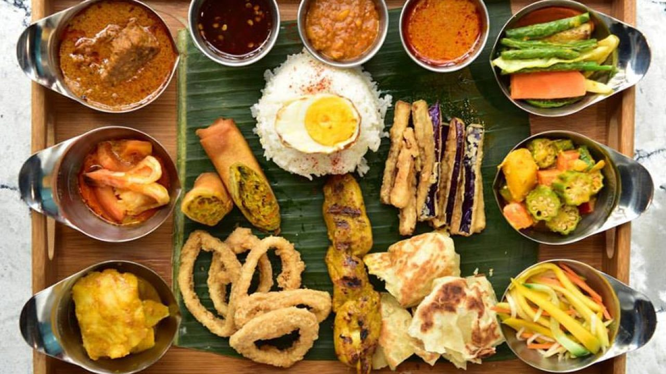

BUSINESS PROBLEM
1
What is best location in New York City for Indian Cuisine?
2
Which areas have potential Indian Resturant Market ?
3
Which all areas lack Indian Resturants ?
4
Which is the best place to stay if I prefer Indian Cuisine ?

Slide 4
DATA
For this project we need the following data :
New York City data that contains list Boroughs, Neighborhoods along with their latitude and longitude.
Data source : https://cocl.us/new_york_dataset Description : This data set contains the required information. And we will use this data set to explore various neighborhoods of new york city.
Indian resturants in each neighborhood of new york city.
Data source : Fousquare API Description : By using this api we will get all the venues in each neighborhood. We can filter these venues to get only indian resturants.
GeoSpace data
Data source : https://data.cityofnewyork.us/City-Government/Borough-Boundaries/tqmj-j8zm Description : By using this geo space data we will get the New york Borough boundaries that will help us visualize choropleth map.

Slide 5
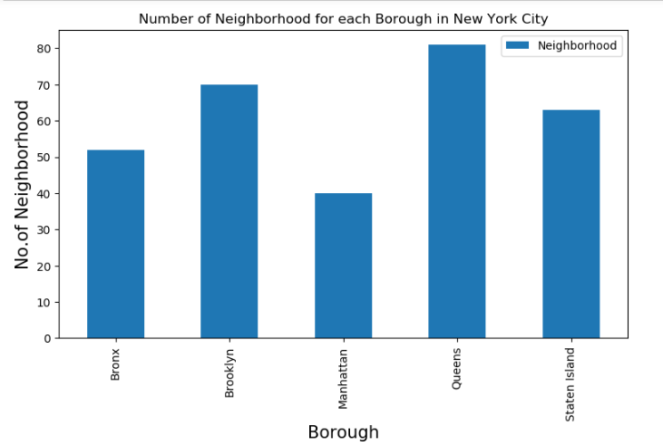
Interim Results
Queens has the highest number of neighborhoods, followed by Brooklyn and Manhattan.

Slide 6
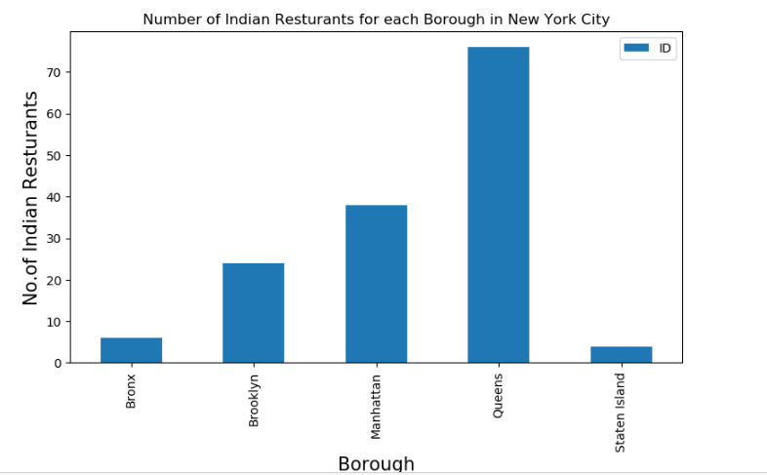
Interim Results
Again, Queens has highest number of Indian restaurants, followed by Manhattan

Slide 7
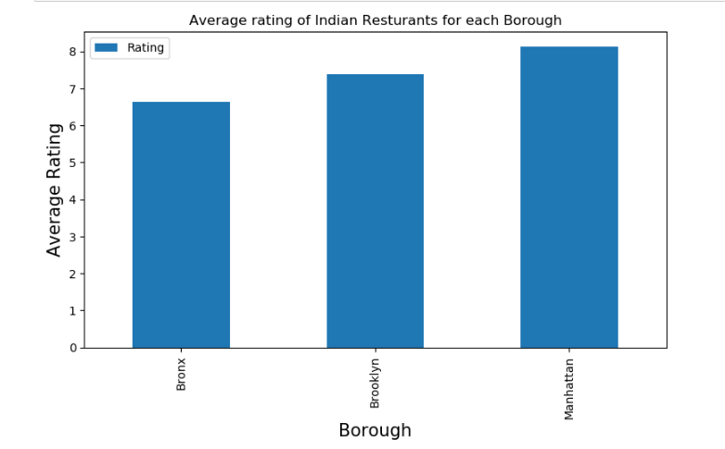


Interim Results:
Now, we wanted to find out the values like no. of likes, ratings and tips given to each restaurant. For, that again, we’ll use Foursquare API to obtain the results.
NOTE: We have a restriction to call 50 premium APIs per day.
So, we’ll consider only first 50 records, for further analysis.
P.S: If you want to get the more better results, you can then upgrade you foursquare account as per instructions.

Slide 8
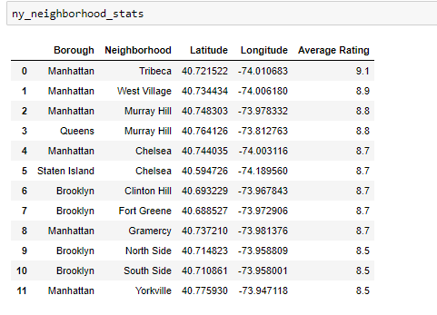
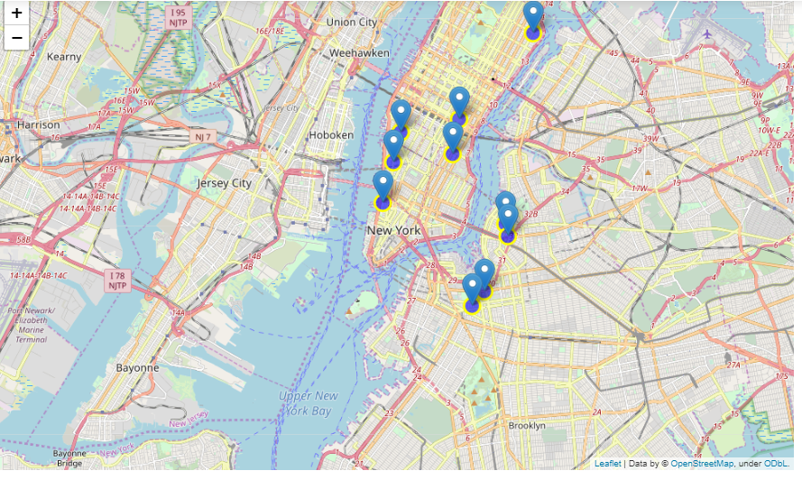

Interim Results:
Mapping neighbourhood data, which holds average rating of >=8.5

Slide 9
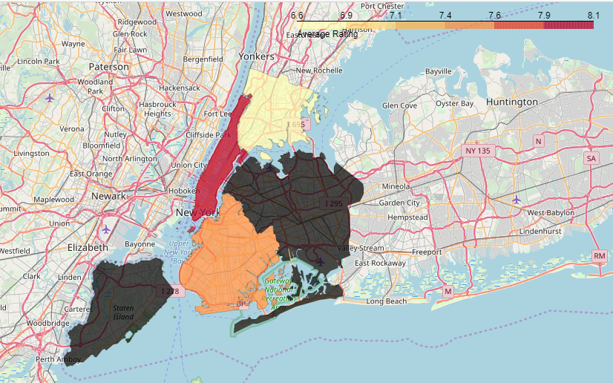
Visualizations of borough on the basis of average rating.
Choropleth Map
Notes:
In Slide Show mode, select the arrows to visit links.

Slide 10
Conclusion and Limitations
Tribeca(Manhattan), West Village(Manhattan), Murray hill(Manhattan), Murray hill(Queens) are some of the best neighborhoods for Indian cuisine.
Manhattan have potential Indian Restaurant Market
Yorkville ranks last in average rating of Indian Restaurants.
Manhattan is the best place to stay if you prefer Indian Cuisine.
Limitations:
The ranking is purely on basis of rating of restaurants.
The accuracy of data depends purely depends on the data provided by Foursquare.

Slide 11

THANKS

